Slide 1
SCIENZA APERTA
Models and Empirical Evidence in Economics: Where We Are?
Metaheuristic Theory of Growth
Prof. FU Jun, Peking University
Member, Academy of Sciences of Bologna Institute

Slide 2
Contents
Central puzzle
Modelling (metaheuristic theory)
Empirical test
Insight and caveat

Slide 3
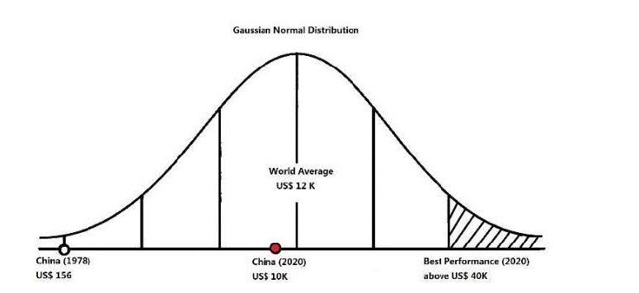
1. Motivating Puzzle

Slide 4
2.1 Metaheuristic Theory of Growth: 4 Sets of Causes
Physical causes (tangible)
Contextual causes (institutional)
Motivational causes (incentives)
Ideational causes (idea gaps)
From Newton to Einstein to biology to neuron science (low → high resolution)
Theory is to be judged by simplicity, consistency, accuracy, scope, and fruitfulness

Slide 5
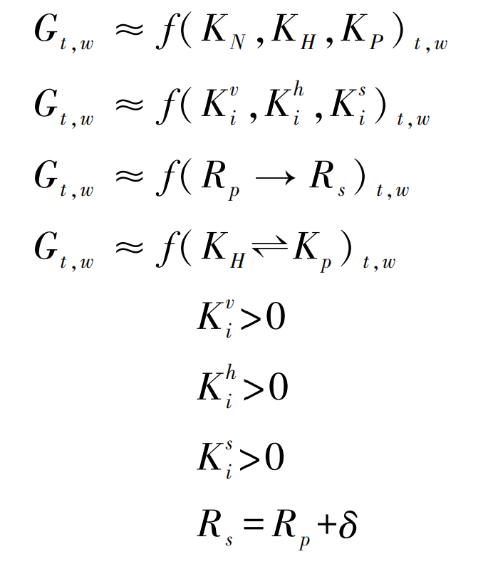
2.2 Metaheuristic Theory in Math Expression
where,

Slide 6
2.3 Metaheuristic Theory of Growth in Integration
This equation connects and integrates macro, mid-level, and micro analyses

Slide 7
2.4 Axiomatic Causes of Growth
G = K_{N}δ_{I}
From Homo Sapient to Homo Deus
Truth is driven by simplicity
Reality is ugly and needs to be reformed
Art vs artwork

Slide 8
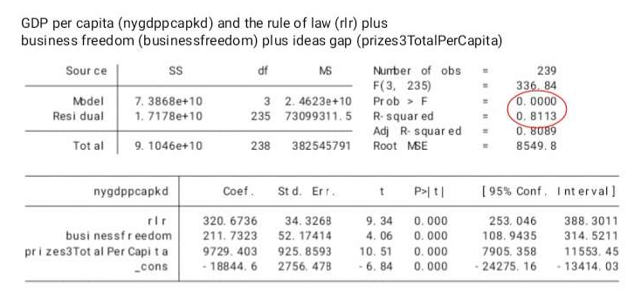
3. Empirical Tests

Slide 9
4. Insight and caveat
Theoria cum praxis (de-contextualize vs contextualize)
Metaheuristic growth (inductive + deductive tinkering)
| Stasis | order | complexity | chaos |
Neo- (behavioralism + structuralism + evolutionism)
Economics vs anthropology in globalization
“Rationality” - Modernization is an unfinished agenda (Habermas)

Slide 10
Grazie
Empirical Data from:
Economic Freedom
Fields, Nobel, and Turing Prizes
Freedom in the World (FIW)
Human Development Index (HDI)
International Property Rights Index
Maddison Project Database
OECD Data
Polity IV
Social Capital Survey
World Development Indicators (WDI)
World’s 100k Top Scientists
Worldwide Governance Indicators (WGI)

